Slide 1
Polymorphism
CS0112 Lab 4

Slide 2
What is Polymorphism?
Ability to write code that works over multiple data types
Example: Functions that have parameters that can take in various data types (str, int, float…)
Useful in terms of reducing the amount of work, code reusability, and reducing bugs

Slide 3
Polymorphism in Python
In python, polymorphism can take multiple forms
Is used when a method’s parameter can be (one of) multiple types of data
Have to define the same method over multiple classes that you want to use polymorphically
After you define the method, variables in your program can have one of the classes(types) that have that method
Inheritance, Abstract Methods

Slide 4
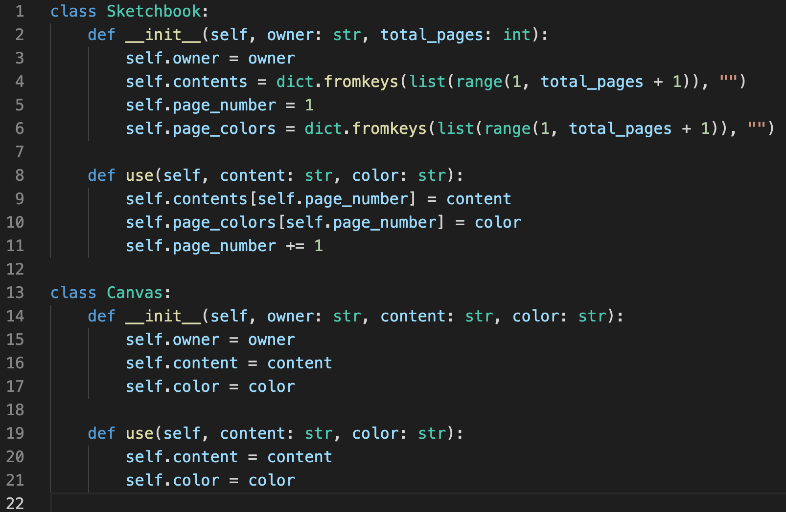
Example: Same method, multiple Classes
Same method, different implementation
Allows for usage of multiple types (classes)
Can call use() method to both classes! (different execution)
Same method!
Different
implementation!

Slide 5
Inheritance
Classes can inherit methods from other classes
This is called “Inheritance”, and there is a superclass and a subclass when this happens
Superclass gives all its methods to subclasses automatically, and subclasses can expand on that

Slide 6
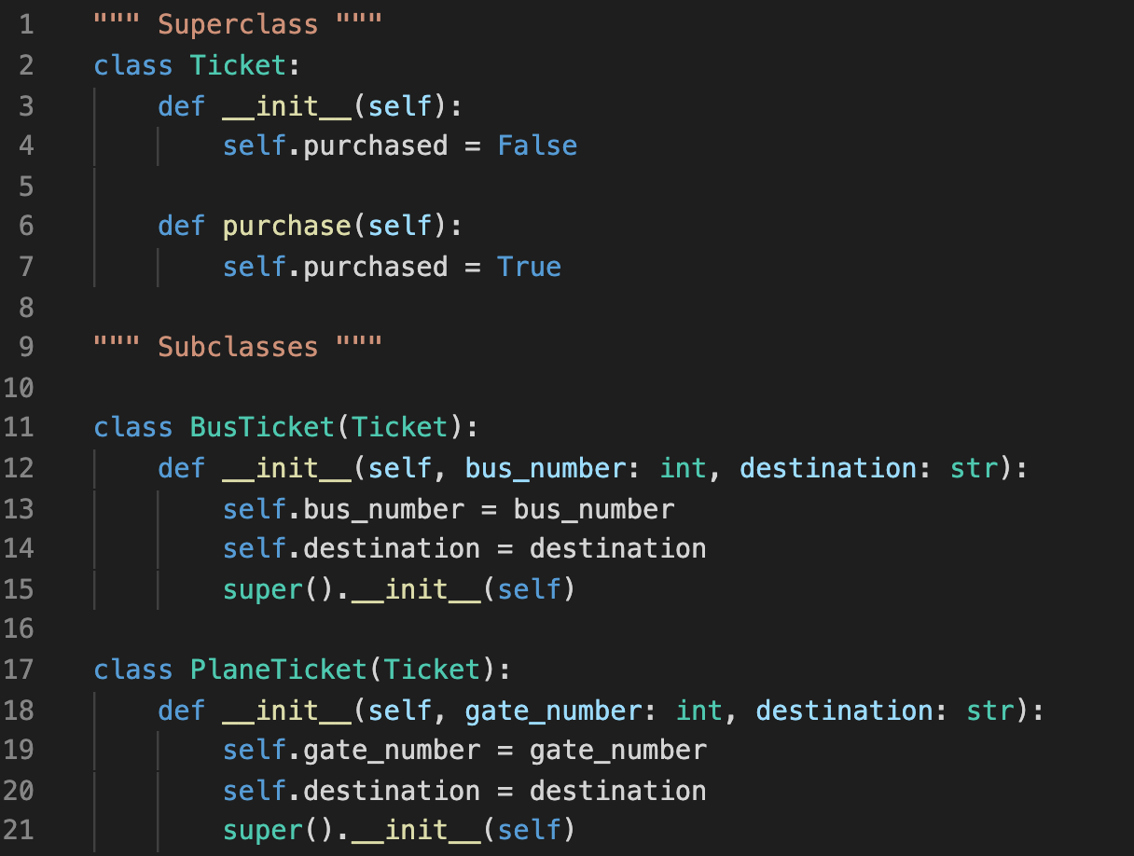
Inheritance - Example
Superclass
Superclass passes on its methods to all of its subclasses
Need super().__init__(self) command to properly inherit method
Subclasses can expand on superclasses’ methods
Subclass
Subclass

Slide 7
Why is Polymorphism Useful?
Code reusability
For example, in inheritance, you can reuse a certain block of code defined in the superclass for your subclasses!
Less code: fewer bugs!
Because of code reusability, you do not have to redefine the same block of code over multiple classes or throughout your program
Flexibility in program
Allows methods to be used for multiple data types

